Slide 1
KASU LASER PRODUCT 2023
- CO2 LASER CUTTING MACHINE ­ CO2 LASER ENGRAVING MACHINE ­
­ FIBER LASER MACHINE ­
WWW.KASULASER.COM

Slide 2
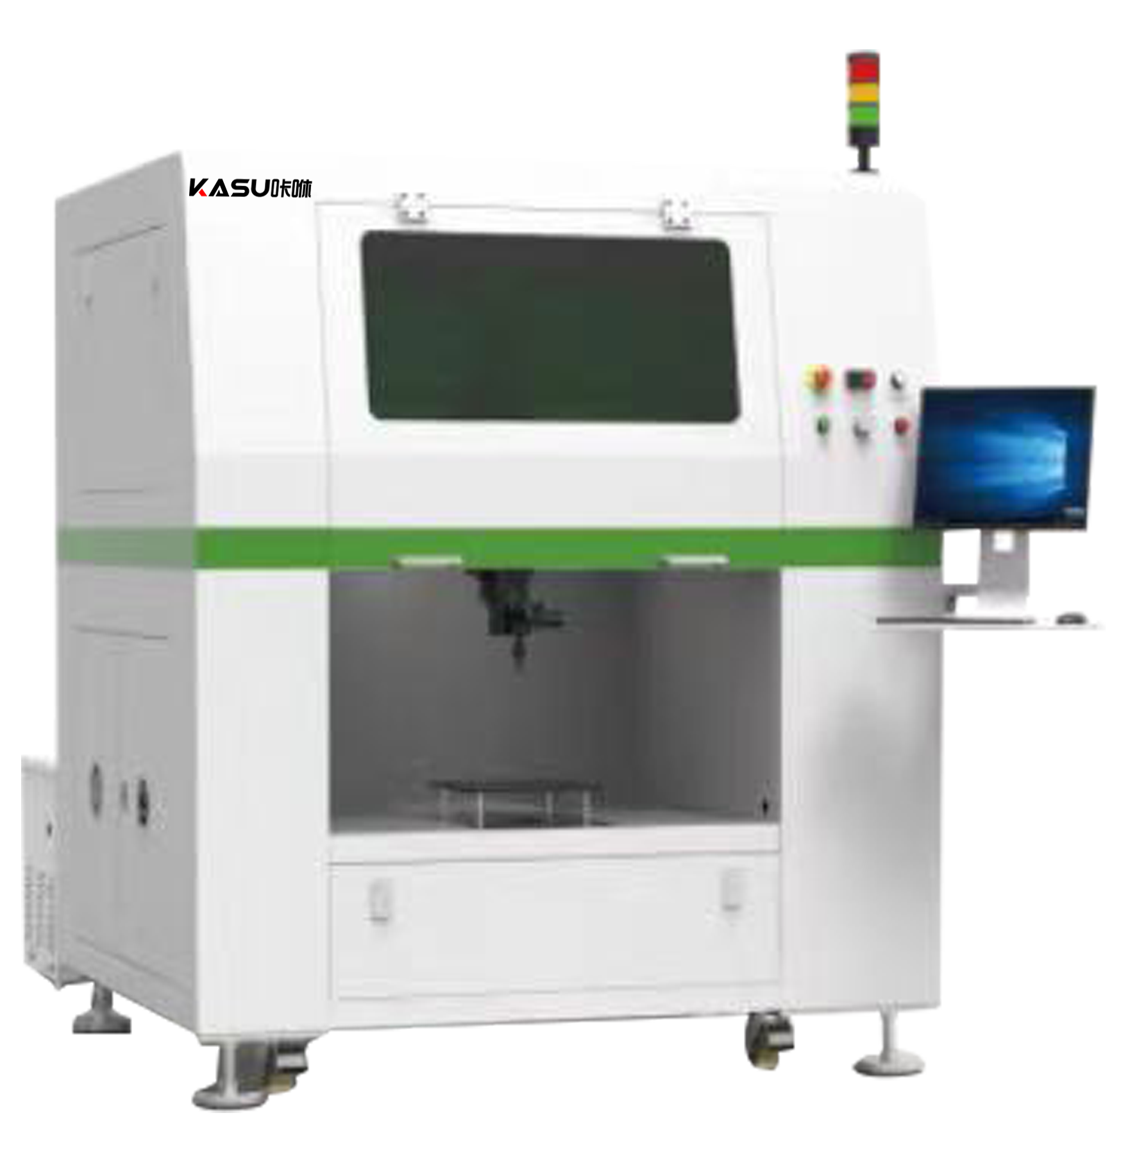
KEY FEATURES >>>
KASU 3D 5-Axis Laser Cutting Machine
The 3D 5-Axis Laser Cutting Machine is a laser cutting machine designed by KASU for 3D laser cutting processing.
The product has manual teaching and offline programming to optimize the cutting path and improve the cutting performance (always maintain a stable focal length and normal direction for cutting).
It is an ideal 3D laser cutting machine for complex multi-face and curved surface products.

Slide 3
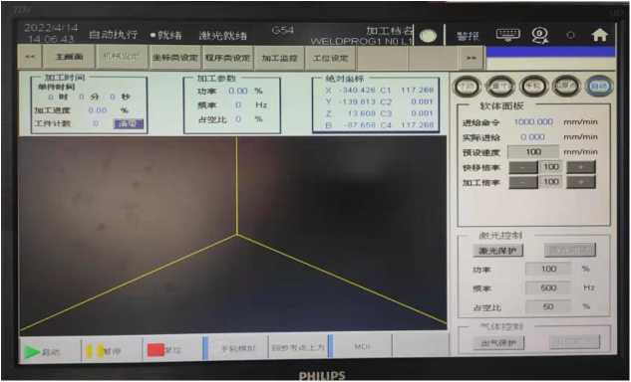
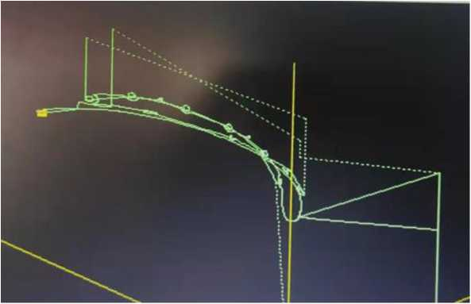
ABOUT THE PRODUCT >>>
Standard equipment with a 21-inch display
wireless keyboard and mouse
Equipped with specialized 5-axis linkage controller
optional offline programming software.

Slide 4
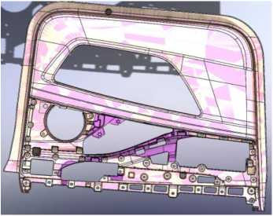
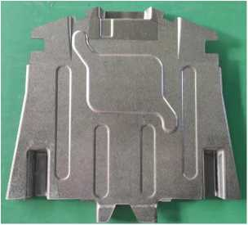
ABOUT THE PRODUCT >>>
The working parts are modularized so that the user can choose the appropriate working table according to the application, and currently there are three main configurations: fixed working parts/single-station rotary working parts/double-station rotary working parts.
Fixed Working Parts
The product is large and needs to be cut on multiple sides, or the cutting path is curved. The product is cut by fixture fixation and 5-axis linkage.

Slide 5
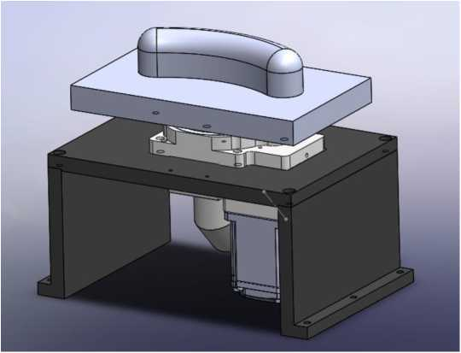
ABOUT THE PRODUCT >>>
The working parts are modularized so that the user can choose the appropriate working table according to the application, and currently there are three main configurations: fixed working parts/single-station rotary working parts/double-station rotary working parts.
Single-station Rotary Working Parts
Small product size and curved cutting path
Cutting is done in a 5-axis system with 4 upper and 1 lower axes, and the C-axis is placed on the lower table.。

Slide 6
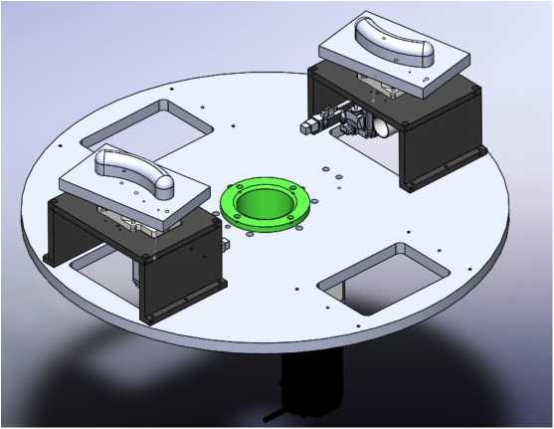
ABOUT THE PRODUCT >>>
The working parts are modularized so that the user can choose the appropriate working table according to the application, and currently there are three main configurations: fixed working parts/single-station rotary working parts/double-station rotary working parts.
Dual-station Rotary Working Parts
Large turntable with 2 small turntables, can be cut by 5-axis/4+1-axis linkage. Effective use of time for maximum efficiency.
Among them: the machining station can be fixed or rotary, depending on the characteristics of the product.

Slide 7
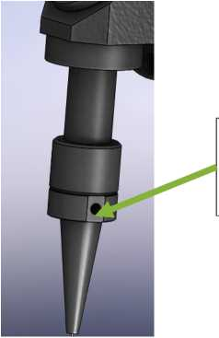
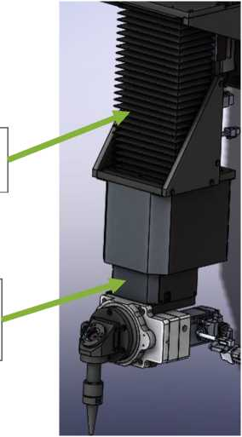
ABOUT THE PRODUCT >>>
The B-axis cutting head part is designed with anti-collision. When the cutting head is subjected to certain lateral force, it will fall off. It avoids the equipment spindle from being stressed, which makes its precision deteriorate or crash.
The Z-axis is encapsulated and dust-proof to prevent dust from entering the BC-axis and affecting the quality of the light beam, which in turn improves the cutting effect of the product.
The c-axis can realize N*360°rotation, and the overall design is more simple and beautiful.

Slide 8
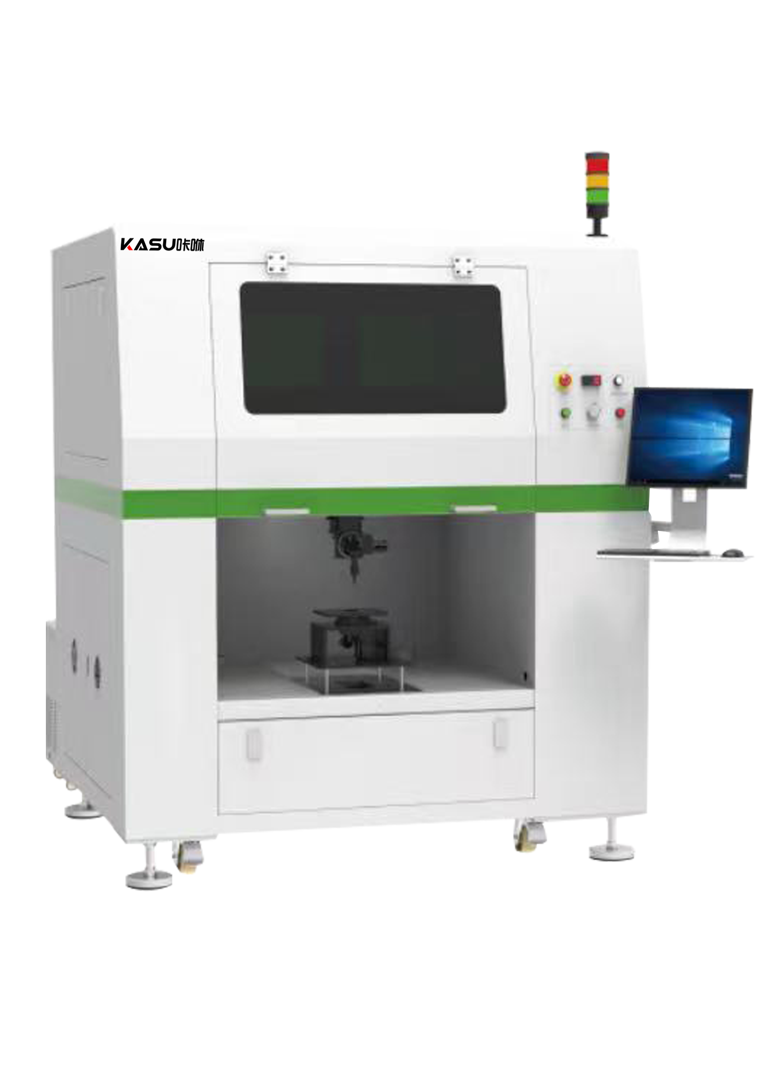
WORKING PARAMETE >>>
Work parameters: KASU 3D 5-Axis Laser Cutting Machine
XYZ Stroke
About 750mm*600mm*200mm
Laser Power
80-300W （RF laser as standard）
Transmission System
Servo motor + linear module + rotary table
Maximum Air Speed
0.5m/s
Cutting Speed
Related to laser power, material material,
thickness and cutting path, etc.
Cut Path Input
Manual teaching method or offline programming
method (3D drawing import + 3-point positioning)
Repeat Positioning Accuracy
±0.05mm
Laser Tube Cooling Methods
water cooling
Working Environment
Temperature 5-40°C: Humidity: 5%-80%, non-condensing
Equipment Power
ABOUT 6.5KW （based on 80W laser tube）
Power Requirements
380V/50Hz
Total Mass (mainframe)
ABOUT 1T
Dimensions
1650mm*1650mm*2250mm

Slide 9
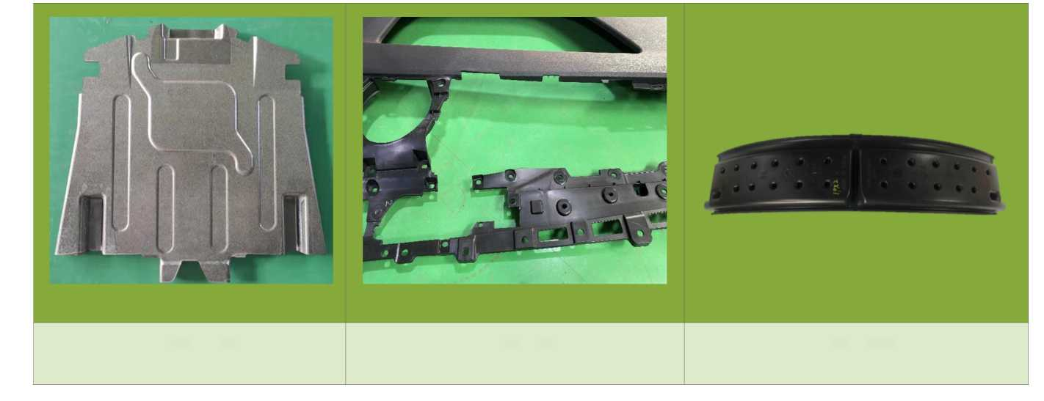
APPLICATION >>>
Battery Cover Effect
Car Door Panel Effect
Wheel Silencer

Slide 10
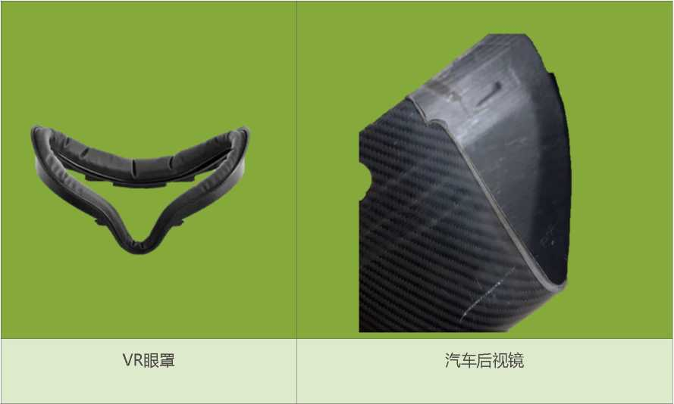
APPLICATION >>>
VR Eye Mask
Car Rearview Mirror

Slide 11
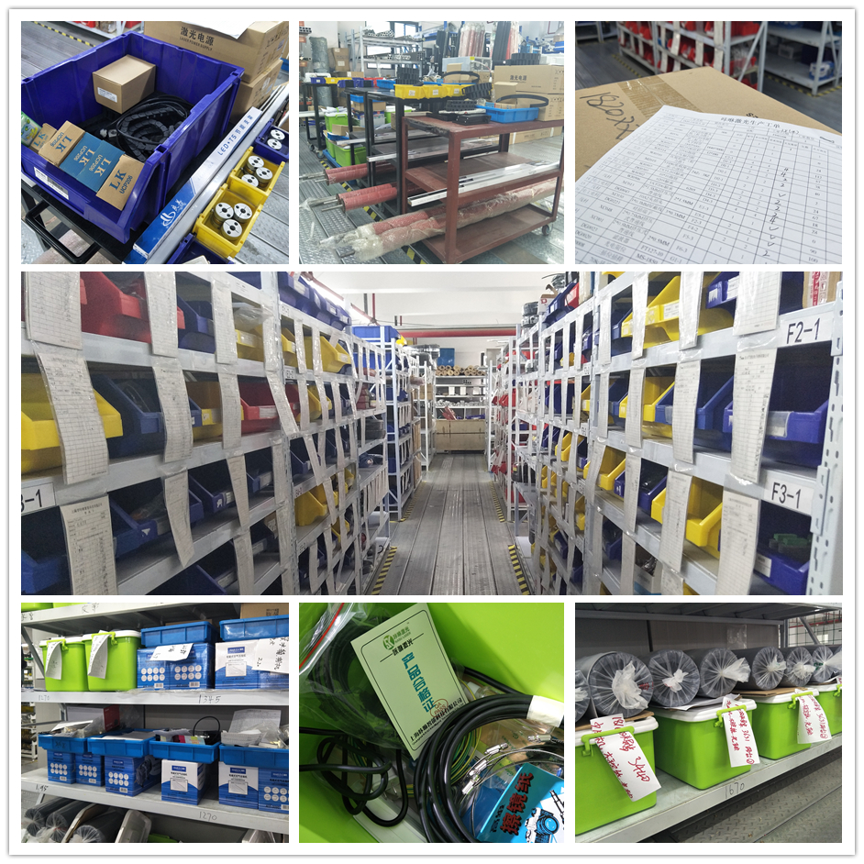
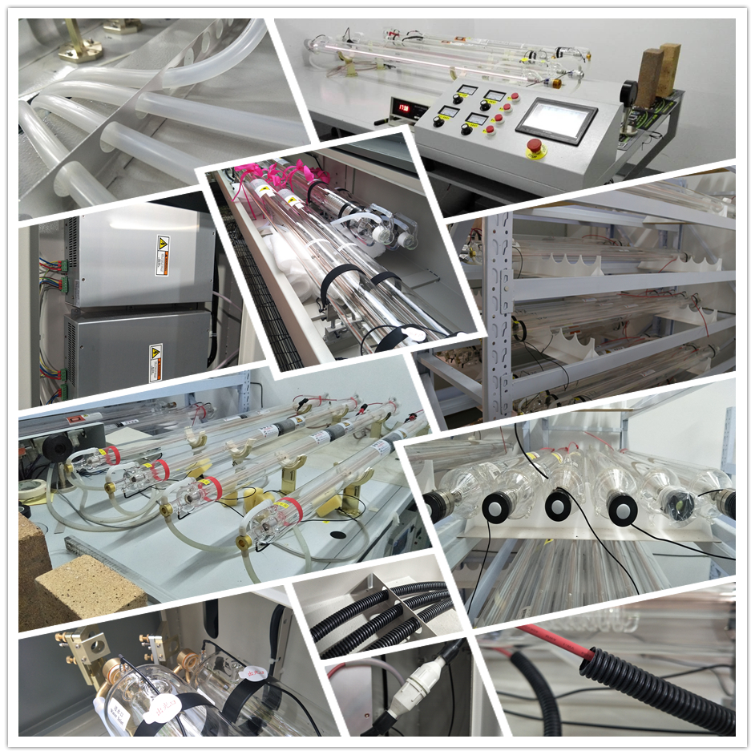
QUALITY CONTROL >>>

Slide 12
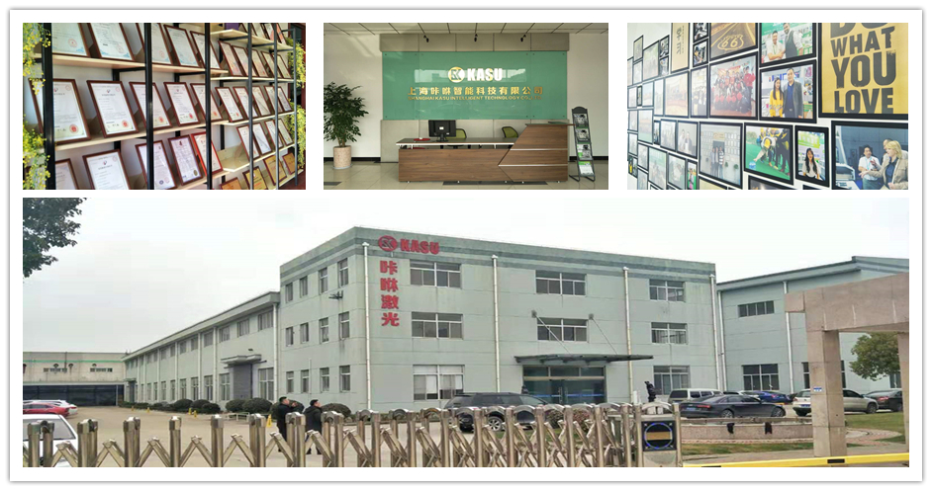
ABOUT KASU LASER >>>

Slide 13
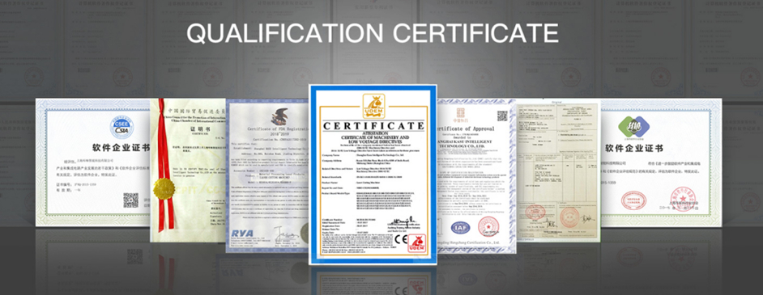
ABOUT KASU LASER >>>

Slide 14
CONTACT US NOW >>>
SHANGHAI KASU LASER
· Co2 Laser Cutting Machine · Laser Engraving Machine·
· Fiber Laser Marking Machine ·
http://www.kasulaser.com
Christina Lu
Wechat & Whatsapp & Cellphone: 0086-186-0171-8317 Email: christina.lu@kasulaser.com

